Slide 1

Fuzzing the Syscon Bootloader
Henry Weller, Robotics Firmware Intern

Slide 2
Intro to Fuzz Testing
Two general classes of fuzzers:
Generational
Mutational
Notes:
Fuzz testing is an example of dynamic code analysis that can be used to discover coding errors and security loopholes in software by inputting massive amounts of random data, called fuzz, to the test subject in order to make it crash.
There are two main types of fuzzers, generational and mutational
Both require an input file directory, or seeds, to generate more test cases
Generational fuzzers follow use an input model to create new, similar testcases. Mutational fuzzers use input test cases which are then mutated to create more test cases. Mutations include bit flipping or appending to change the input data into something new.
Since we are looking for test cases that are similar to an input packet frame, a mutational fuzzer is more appropriate.

Slide 3


Fuzzer Options Available
Notes:
These are some of the fuzzers I looked at when deciding what to test the bootloader with
Peach fuzzer has a really clean UI and is very easy to get started with, but it only supports generational fuzzers so it isn’t right for our application
Sully is a very powerful fuzzer that supports parallel fuzz tests on the same binary, but its also a generational fuzzer

Slide 4
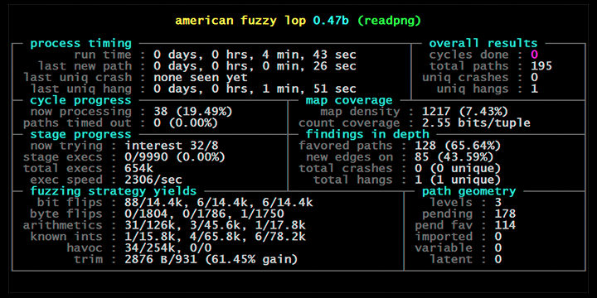

Introducing American Fuzzy Lop
http://lcamtuf.coredump.cx/afl/
Notes:
This fuzzer is mutation-based, mutates input cases using genetic algorithms instead of randomly like traditional mutation-based fuzzers, and is open-source and offers a lot of community support in terms of debugging issues
Pulls test case from directory off of a stack, and uses genetic algorithms to create mutated copies which then get added to the stack.
Travels through multiple levels of mutation,

Slide 5
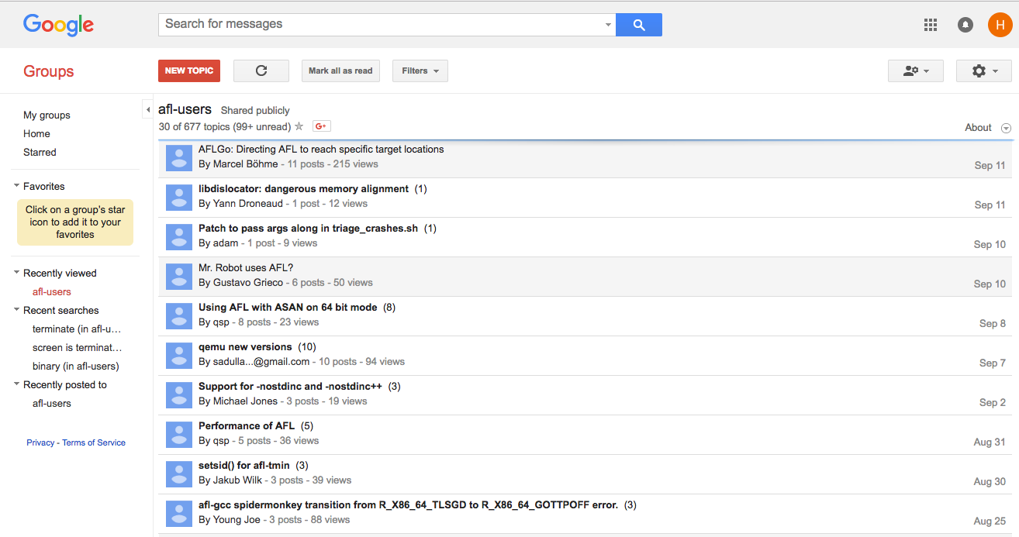
AFL Community and Support
Notes:
Do it yourself, good for learning how to work with these systems
Great community-support
Michael Zalewski, original creator, responds to posts and has created great documentation for the tool

Slide 6
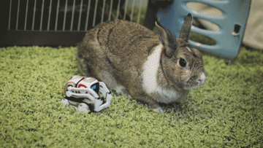
Victor and American Fuzzy Lop

Slide 7
Properly Instrumenting the Binary in Test
Make sure you have properly built the version of the AFL compiler you are trying to use before you run it on your targeted application
Set the AFL compiler to the latest version of clang, suitable for your machine
Set the programs compiler to the AFL compiler (e.g. afl-clang++)
Notes:
It’s important to set both the afl compiler and the system compiler
Follow the instructions for how to set up clang in LLVM mode
Insert into your main loop a wrapper loop which continuously runs your function
__AFL_LOOP(), which allows AFL to basically perform the fuzzing of the binary in process through some memory wizardry, as opposed to starting up a new process for every new testcase we want to test

Slide 8
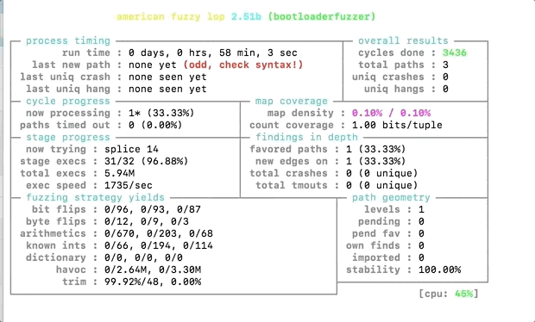
Fuzzing the Bootloader (Level 1)
Notes:
Do a brief walkthrough of what instrumenting the process was like
Explain what each of the variables means
Why the path geometry section is important?

Slide 9
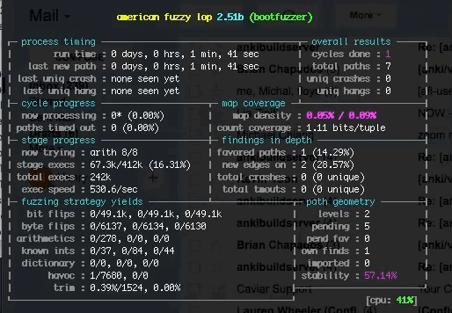
Fuzzing the Bootloader (Level 2)

Slide 10
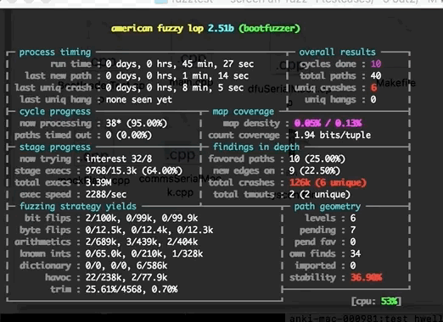
Functional Fuzzer (Round 1)
Notes:
Notice the 126k crashes, only 6 of which are unique!

Slide 11
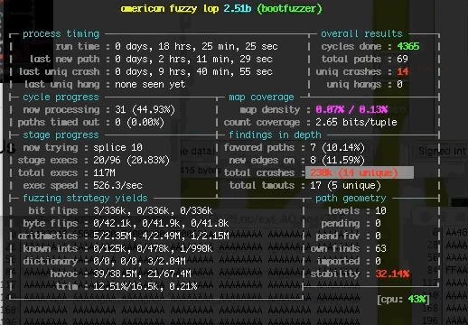
Functional Fuzzer (Round 2)
Notes:
Note the amount of time that has passed since a crash has happened, left this guy spinning overnight and it seems like it might have exhausted its search for crashes.

Slide 12
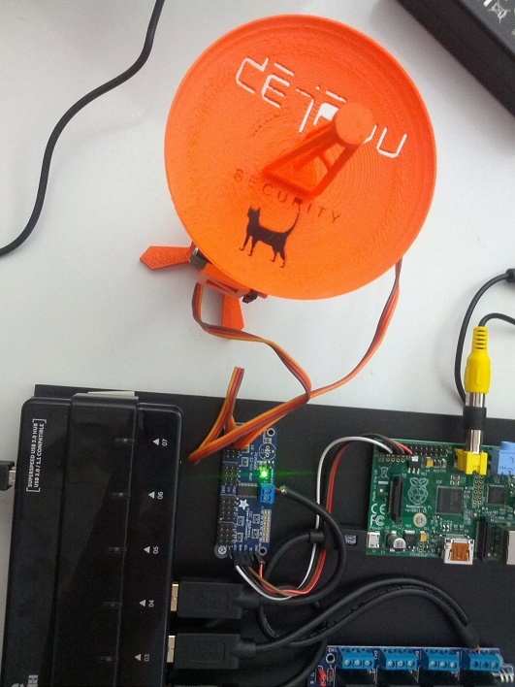
Where this Leaves Us
Notes:
A future step would be to set-up AFL so that it can run on the actual bootloader hardware to test any bugs in the silicon in addition to those in the software
One of the great value adds is the fact that we have this tool at our disposal for testing other libraries, e.g. bignum.cpp

Slide 13

Special Thanks to
Daniel Casner and Adam Shelly

